Slide 1
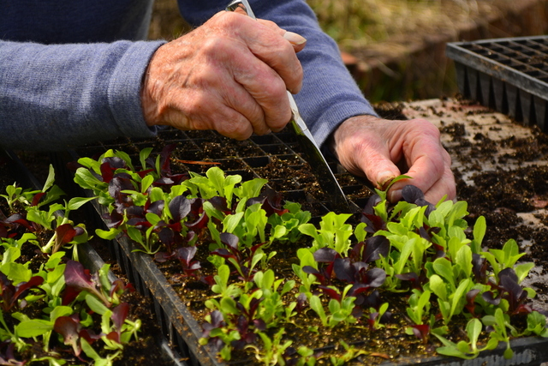
Care Farms for People Living with Dementia
Eilon Caspi
Land Stewardship Project Farm Beginnings Course
Permission to use the image was given by Flathead Care Farming, made by Sharee Tompkins

Slide 2
Care Farm “De Port” for elders with dementia in Keplen-Oler in the Netherlands:
https://vimeo.com/109903443
An overview of Green Care Farms in the Netherlands:
https://flatheadcarefarming.wordpress.com/links/
Notes:
3-minute video

Slide 3
Growth in # of Care Farms in Europe
In 1997 there were only 75 Care Farms in the Netherlands... (Hassink)
"There are currently about 1,100 green care farms in the Netherlands, about 15% of which are open to people with dementia” (de Bruin et al. 2015)
Number of Social/Care Farms in other European countries:
Norway = 550; Italy = 350; Flanders = 260; Austria = 250;
Germany = 170; Ireland = 90; UK = 45 (Hassink)
Notes:
From 10 Care Farms open to elders in 2001 to 25 Care Farms in 2009 (Hassink’s PPT)
[“Flanders” = Dutch-speaking northern portion of Belgium]
15% of 1,100 Care Farms = 165 farms open to people with dementia!

Slide 4
“I feel useful. It contributes to my dignity. I feel appreciated, the things I do. I have something to offer; to other people, the soil, to the fruits. Yeah, I like that.”
– An elder with dementia on a Care Farm
(de Bruin et al. 2015)
Notes:
Share briefly about the elder who was sick and called to apologize that he can’t come to help that day… A reason to wake up in the morning!

Slide 5
Potential therapeutic benefits of participation of people with dementia on Care Farms: http://tinyurl.com/p36l9kd
Care Farms can serve clients with dementia either as Day Programs or Residential Care Homes.
Notes:
To have meaning and purpose in their lives; to feel useful and to contribute to one’s community; to feel valued; to have a reason to wake up in the morning; to have a life worth living!
To feel normal again. Not to experience the terrible stigma often felt by PwD. To enjoy the health and psychological benefits of being in the outdoors. There’s a hidden program in Care Farms, which is the physical activity that people do while working on the farm. There are also tremendous therapeutic benefits of working with and caring for various animals… Another big piece is the intergenerational nature of many of these farms, which brings its own therapeutic benefits. AND many of these qualities already exit naturally on farms when in nursing homes and at home we need to create them artificially…
To enjoy the humane approach by the farmer who treats them as equals, as partners, as co-workers… They don’t feel sick any more.
In addition, there are benefits for family care partners…such as respite.
There are also Care Farms that provide end of life care.

Slide 6
Major Gap In U.S. Health Care System
Lifeside Care Farming / Flathead Care Farming in Kallispell Montana:
https://flatheadcarefarming.wordpress.com
Maarten Fischer won the 2015 Mather LifeWays Institute on Aging Promising Practices Award!
http://tinyurl.com/gqjdgtm
Notes:
i.e. to my knowledge, very little in the U.S. = The only program I am aware of is of my colleague Maarten Fischer in Montana…

Slide 7
How do we bridge this gap?
Notes:
I’d love to discuss this with you and anyone interested in exploring this with us…
We need to continue and learn from what has already done in Europe and adapt it to the U.S. as well as to learn from Maarten’s work in Montana…
Continue to raise awareness to this innovative model; we held a couple of radio shows, disseminated a piece about it, and this month my colleague will present a poster in ASA
Continue to meet with farmers…
Meet with agencies in the aging field…
+ Other activities which I’ll share more about in a minute…

Slide 8
Purchasers of Care Farm Services in Montana
Medicaid (Elders and Physically Disabled Waiver Program)
Older American Act (County Agency on Aging)
Veterans Administration (as a form of Respite)
Vocational Rehabilitation (includes elders)
Subcontracting with nursing homes and assisted living residences
Private pay

Slide 9
Reimbursement to Farmers in Montana
Normal rate is $75 per client for a 5 hour day
Maarten pays the farmer $50 per day
Spends on average $12 on transportation
The rest goes to office work
On average, clients attend once a week (some 4 times a week while others twice a month)
Maarten currently partners with 11 Care Farms with 70 clients (about 10 with dementia)
Notes:
It is not like the farmer is going to make a lot of money…
Spends $12 on average (b/w $0-$25) on transportation
If you have 4 clients per day, each attending for 5 hours, you get $200. (assuming that local large payers will agree to pay for the program).
If you provide this service to these 4 clients for 50 days per year (once a week), you’ll get $10,000.
To reach a critical mass = 60-100 clients with an average of 1.5 times per week per client.

Slide 10
Potential Concerns / Barriers
Stigma and misconceptions about people with dementia
Collaboration b/w agriculture sector & health sector
Funding arrangements: Convincing large payers to reimburse the service
Getting into referral streams
Safety issues (Risk Assessment)
Liability concerns & insurance (“Litigation Culture” in U.S.)
“Cheap labor”
Slow production rate
Seasonal cycles
Weather
Transportation issues (inc. participants’ distance to Care Farms)
Balancing my time b/w this initiative and other work commitments…
Other barriers or concerns?
Notes:
Time commitment (mine).
Education and Training to farmers (orientation = 20 hours and ongoing training 12 hours) will reduce misconceptions and address safety concerns…
Risk assessment. Dozens of potential safety risks and what the farmer will do to mitigate them… Treating the person as a person comes with risks…
+ “Code of Practice” (UK) = a set of guidelines, aiming to meet the requirements of commissioners, clients and other stakeholders to ensure that care farms which adhere to the code of practice are safe, professional and effective (Care Farming UK, 2014).
Slow production rate. It’s about healing. Maarten: “It will only work if they consider themselves as a health care provider for that day.”
Seasonal cycles. For example, an organic vegetables farm. In the summer it won’t work. They are too busy!
Transportation issues. Has to be dementia-friendly transportation. Drivers must receive training…
+
My distance from the farm may also be an issue…depending on how many times per week I’ll need to be there…
Insufficient initiatives by farmers…
…
Down the road opening a farm for people with dementia… Investors… after showing some success with a day program…

Slide 11
A word about taking risks…
“The paradoxical effect is that if you pay less attention to risk and more attention to living, it actually reduces risk.”
Maarten Fischer: “When you are on a farm, there are risks. Treated as a real person, that comes with risks.”
This is not to suggest that we should ignore potential risks for people with dementia on Care Farms…
A dementia-specific Risk Assessment Protocol must be developed, reviewed by farmers, and all identified issues must be proactively addressed…
Notes:
Btw, there are plenty of risks for PwD living in a nursing home or even at home!
In the words of Maarten, “When you are on a farm, there are risks. Treated as a real person, that comes with risks.”
The risk assessment includes dozens of potential risks and what the farmer will do to mitigate them…
We are currently working on adapting it to people with dementia…

Slide 12
Next Steps / Goals
Go slow!
Start small!
By the end of the Farm Beginners Course:
Hold educational event with all interested farmers
Identify and seek commitment from 2 farmers
Meet 3 large payers and make the case…
Meet 2 aging-&-dementia-specific referral agencies
Identify and encourage a few PwD to participate
Notes:
Mention my Letter to farmers (Thanks Dori for working with me on it) which will go out around March 26 to farmers in MN and WI…as well as a paragraph in LSP Newsletter.
Meet referral agencies. Meet agencies such as home health agencies and make the case for referral to the program (as Maarten has done in Montana)
Optional, [if I’ll have time]: Develop dementia-specific Risk Assessment Protocol for Care Farms.
Continue to maintain my archival blog on this model…

Slide 13
“People with dementia may have something important to teach the rest of humankind.
If we make the venture one of genuine and open engagement, we will learn a great deal about ourselves”
– Professor Tom Kitwood. Author of the groundbreaking book Dementia Reconsidered: The Person Comes First

Slide 14
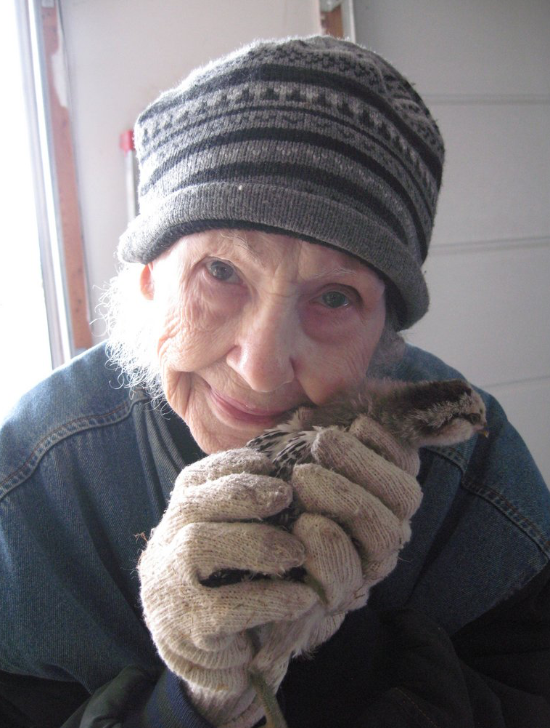
Questions / Discussion
Permission to use the image was given by Flathead Care Farming, made by Lighthouse Christian home

Slide 15
Additional Resources
Video presentation by Dr. Jan Hassink, a pioneer researcher and expert on Care Farms for various populations (including elders with dementia) at Nature Heals Symposium, MN (hosted by UNM Center for Spirituality & Healing):
http://mediamill.cla.umn.edu/mediamill/display/999241160
Judy Berry, president, Dementia Specialist Consulting:
http://www.dementiaspecialistconsulting.com

Slide 16
Additional Resources (cont.)
The Connected horse Project, CA: http://www.connectedhorse.com
Nick Even’s farm in Bay City, WI:
http://www.rivertowns.net/content/different-kind-nursing-home
Community Homestead in Osceola, WI:
http://www.communityhomestead.org/About_Us.html
Notes:
Thank Teresa for connecting me with Nick Even…
We also visited Buttermilk Falls Fram (in Osceola, next door to Community Homestead).

Slide 17
Literature & Research Studies
Berget, B. et al. (2012). Green care farms in the Nordic countries: A research field in progress. Report from the Nordic research workgroup on Green Care in Trondheim, June 2012. See for example pages 30-32 and Table 1 on pages 18-19.
Bruin, S.R. et al. (2015). Green Care Farms: An innovative type of adult day service to stimulate social participation of people with dementia. Gerontology & Geriatric Medicine, Open Access, pages 1-10.
Bruin et al. (2010). The concept of green care farms for older people with dementia. Dementia, 9(1), 79-128.
Bruin et al. (2009). Day care at green care farms: A novel way to stimulate dietary intake of community-dwelling older people with dementia? The Journal of Nutrition, Health, & Aging, 14(5), 352-357.
Bruin et al. (2009). Green care farms promote activity among elderly people with dementia. Journal of Housing for the Elderly, 23, 368-389.

Slide 18
Literature & Research Studies (Cont.)
Buist, Y. (2016). Connect, prioritize, and promote: A comparative research into the development of care farming in different countries from the transition perspective. Internship Report. Wageningen University.
Hassink et al. (2010). Care farms in the Netherlands: Attractive empowerment-oriented and strengths-based practices in the community. Health & Place, 16, 423-430.
Hassink et al. (2012). Care farms in the Netherlands: An unexplored example of multifunctional agriculture – Toward an empirically grounded, organization-theory-based typology. Rural Sociology, 77(4), 569-600.
Schols & van der Schriek-van Meel (2006). Day care for demented elderly in a dairy farm setting. JAMDA, 7, 456-459.

Slide 19
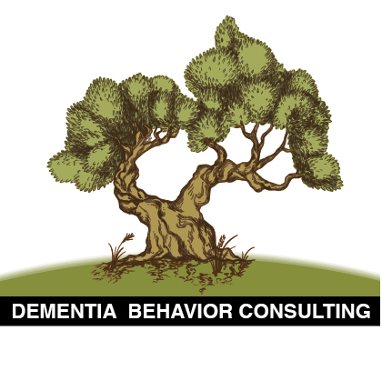
Contact Information
Email: eiloncaspi@gmail.com
Website: http://dementiabehaviorconsulting.com
Archival Blog on Care Farms for People with Dementia: https://www.tumblr.com/blog/carefarmsdementia

